Slide 1
Second Hand Car Price Prediction
Exploring Key Factors and Prediction Techniques

Slide 2
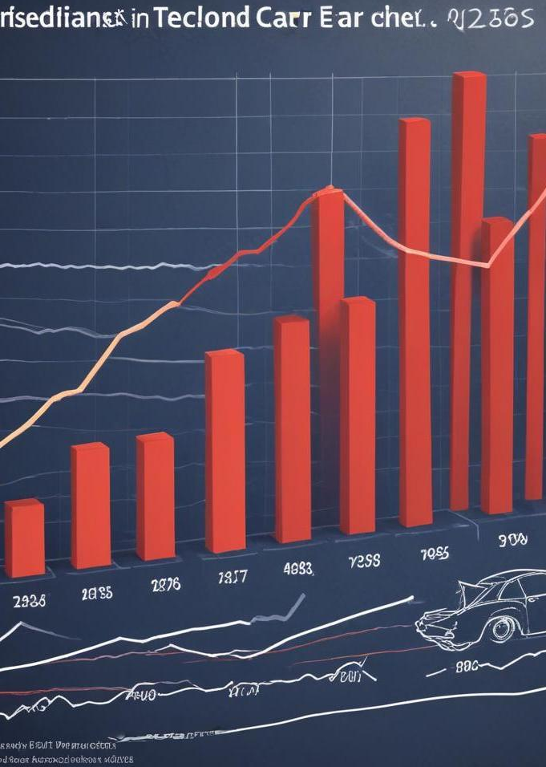
Introduction
This presentation explores the various elements that impact the pricing of second-hand cars and the techniques employed for accurate price prediction.

Slide 3
Factors Affecting Price
01

Slide 4
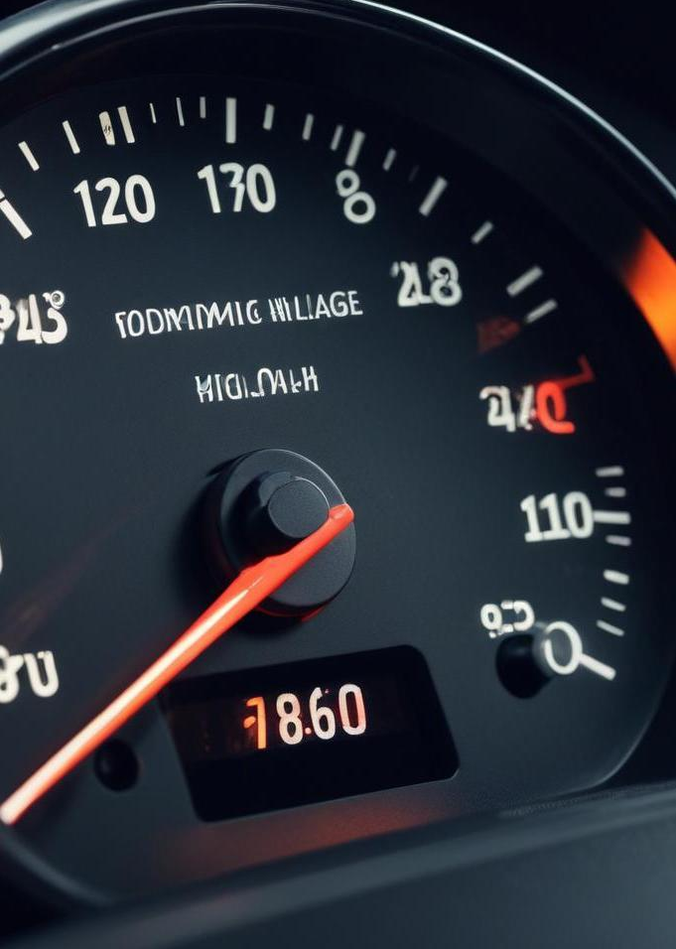
Mileage Impact
Mileage is a critical factor affecting the price of second-hand cars. Higher mileage typically corresponds to greater wear and tear, which can reduce a vehicle's market value. As mileage increases, potential buyers may perceive the car as less reliable, resulting in lower demand and, consequently, lower prices.

Slide 5
Age of the Car
The age of a car significantly influences its price. Generally, cars depreciate in value over time, with the most significant drop occurring within the first few years. Older models may have outdated technology or lack modern safety features, making them less desirable to buyers. However, classic cars may retain or even appreciate in value depending on their condition and rarity.

Slide 6
Brand Reputation
The reputation of a car brand greatly impacts its resale value. Well-known brands with a history of reliability and quality often retain higher prices. Brands that are viewed as luxury or premium tend to have more robust resale values compared to lesser-known brands. Additionally, consumer perceptions of customer service, warranty support, and overall satisfaction can play a significant role in how much buyers are willing to pay.

Slide 7
02
Prediction Methods

Slide 8
Linear Regression
Linear regression is a statistical method used to model the relationship between a dependent variable and one or more independent variables. In the context of car price prediction, linear regression can analyze how factors such as mileage, age, and brand influence price. By fitting a linear equation to the observed data, analysts can gain insights and make forecasts about future car prices based on historical trends.

Slide 9
Machine Learning Techniques
Machine learning techniques employ algorithms that allow computers to learn from and make predictions based on data. In second-hand car price prediction, methods such as decision trees, random forests, and neural networks can be utilized. These techniques can analyze vast datasets to identify complex patterns and relationships among various factors, providing more accurate price predictions than traditional methods.

Slide 10
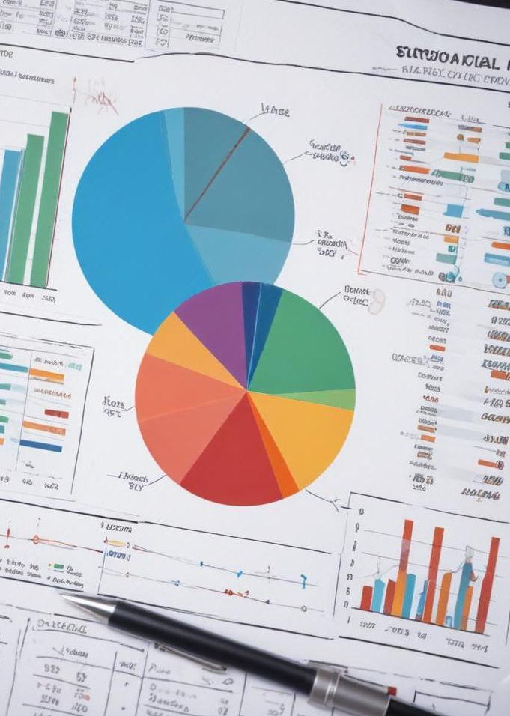
Statistical Analysis
Statistical analysis involves collecting and interpreting data to uncover trends and relationships that inform predictions. In the world of second-hand cars, statistical methods can help identify correlations between features such as age, mileage, and price. Techniques like hypothesis testing and confidence intervals allow analysts to draw conclusions about average prices and expected value ranges, improving the reliability of predictions.

Slide 11
Conclusions
In summary, several critical factors influence second-hand car prices, including mileage, age, and brand reputation. Various prediction methods, such as linear regression and machine learning techniques, provide effective strategies for forecasting prices. Understanding these elements not only aids buyers and sellers but also enhances the overall market dynamics.

Slide 12
Thank you!
Do you have any questions?
+91 620 421 838

